Slide 1

Air Quality Index Prediction Using Ridge and Lasso Regression
Machine Learning | Sec-8 | Team-06
Penneti Bindhu Madhavi – 2520030077 Mandapati Keerthi Sri – 2520030079
Guided by Shaik Asif, Assistant Professor, CSE
Department of Computer Science & Engineering — A.Y. 2026–27

Slide 2

Problem Statement
Increasing air pollution adversely affects human health and ecosystems. Accurate short-term AQI prediction from pollutant and environmental parameters supports early awareness, targeted advisories, and data-driven mitigation decisions.
Goal: Build a robust regression pipeline that predicts AQI using measured pollutants and meteorological features to inform monitoring and response.

Slide 3
Objectives
Predict AQI
Train ML models to estimate AQI from sensor and weather inputs.
Analyse Parameters
Examine pollutant and meteorological behavior and distributions.
Perform EDA
Explore missing data, distributions, and correlations.
Apply Ridge & Lasso
Implement L2 and L1 regularized linear models.
Compare Models
Evaluate using regression metrics and residual analysis.
Select Approach
Recommend the more suitable regression technique for this dataset.

Slide 4
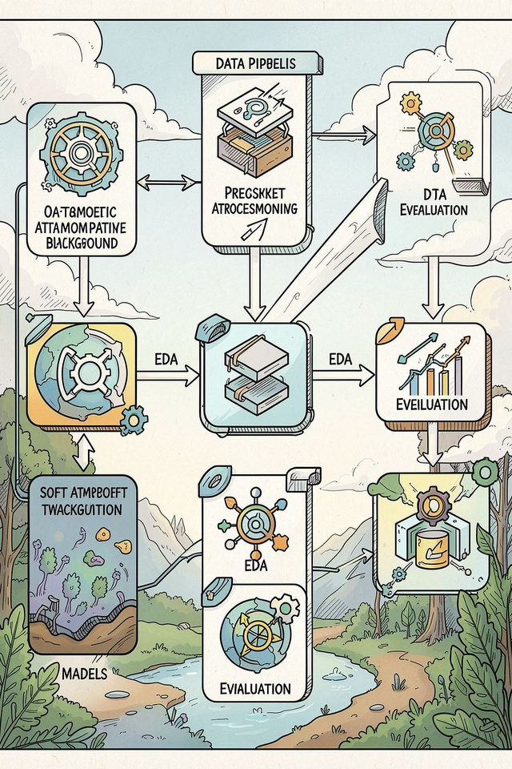

Proposed Solution — Workflow
Air Quality
Data
EDA & Feature
Train-Test
Feature
Dataset
Preprocessing
Selection
Split
Scaling
The system ingests global air-quality records, applies deterministic preprocessing and feature engineering, then trains Ridge and Lasso models. Evaluation compares generalization and feature relevance to guide deployment decisions.

Slide 5

Machine Learning Models — Ridge vs Lasso
Ridge Regression (L2)
Lasso Regression (L1)
Linear regression with L2 penalty
Shrinks coefficients but keeps all features Reduces variance; helps multicollinearity
Good when many correlated predictors contribute modestly.
Linear regression with L1 penalty
Can zero out coefficients → embedded feature selection Promotes sparse models and interpretability
Useful when a subset of features drives the target.
Comparison (summary)
Property
Ridge
Lasso
Regularization
L2 — coefficient shrinkage
L1 — coefficient sparsity
Feature Selection
No (keeps all)
Yes (can zero coefficients)
Best for
Multicollinearity, many small effects
When few predictors are important

Slide 6
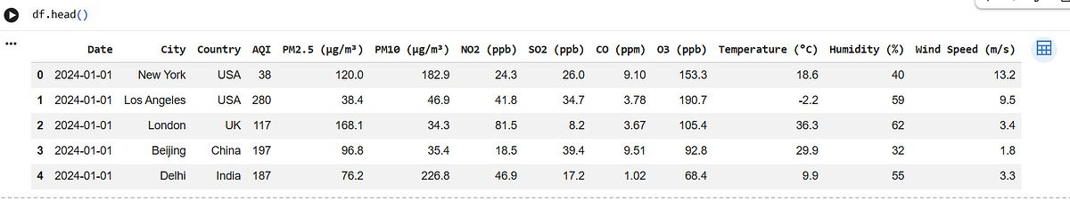

Dataset Identification
Dataset: Global Air Quality Dataset
Source: Kaggle — File:
global_air_quality_dataset.csv
Features
PM2.5 (µg/m³) PM10 (µg/m³) NO2 (ppb)
SO2 (ppb) CO (ppm) O3 (ppb)
Temperature (°C) Humidity (%) Wind Speed (m/s)

Slide 7
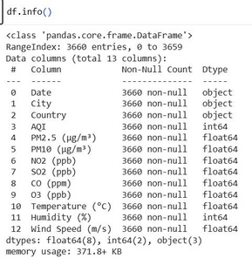
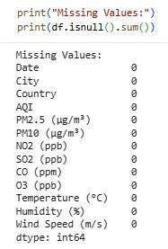


Dataset Analysis — EDA Dashboard (Placeholders)
Below are dashboard panels for Colab outputs. Do NOT add values here — paste results from the notebook.
Shape
Columns and
Missing Values
Duplicates
Number of Rows: 3660
Number of
Columns: 13

Slide 8
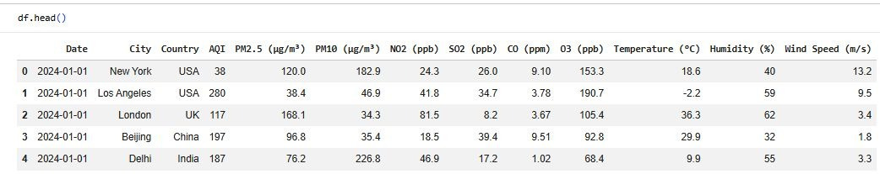

Statistical Summary

Slide 9
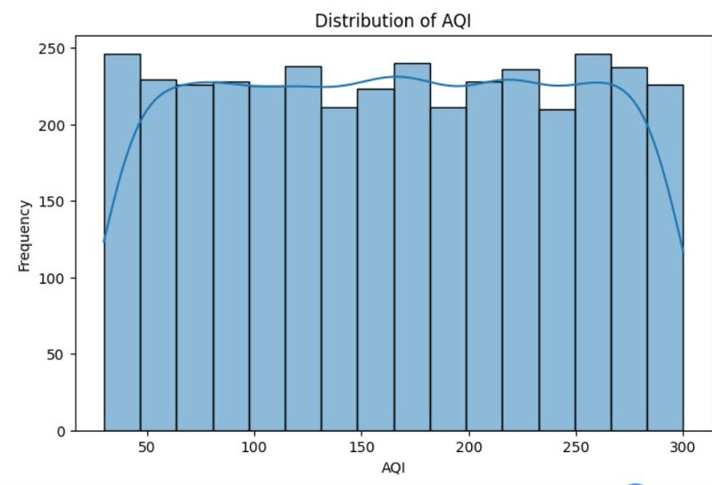
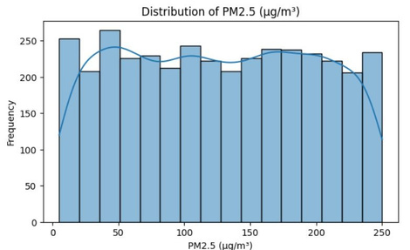
EDA Visualizations — Insert Colab Graphs
AQI Distribution
Pollutant Distributions

Slide 10
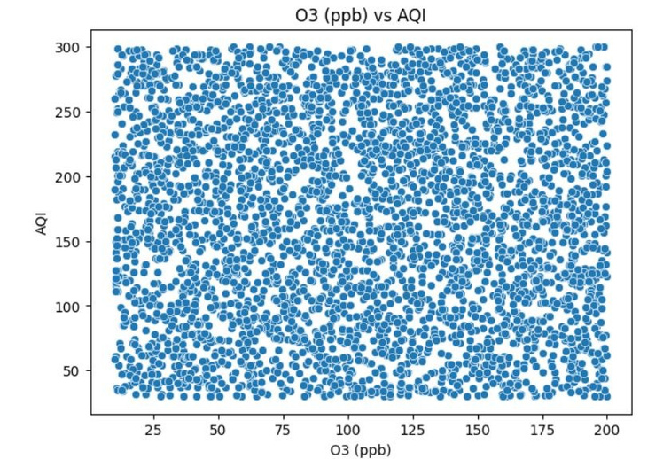
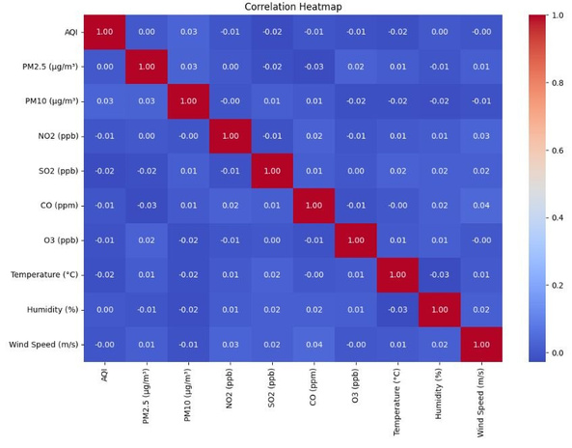
Pollutant Distributions
Correlation Heatmap

Slide 11
EDA — Preliminary Findings
AQI Distribution: The dataset contains 3,660 AQI observations. AQI ranges from 30 to 300, with a mean of 164.64 and median of
165, showing considerable variation in air-quality levels.
Pollutant Distributions: The dataset includes PM2.5, PM10, NO₂, SO₂, CO and O₃, along with temperature, humidity and wind speed
for AQI analysis.
Pollutant–AQI Relationships: Scatter plots were generated to examine the relationships between PM2.5, PM10, CO, NO₂, SO₂, O₃
and AQI.
Correlation Analysis: A correlation heatmap was generated for the numerical air-quality and environmental parameters to examine
relationships and possible multicollinearity.
Missing Values: No missing values were found in any of the 13 columns, so no missing-value imputation was required.
Duplicate Records: The dataset contains 0 duplicate rows, so no duplicate-record removal was required.
Count = 3660 | Mean = 164.64 | Std = 78.57 | Min = 30 | Median = 165 | Max = 300.

Slide 12

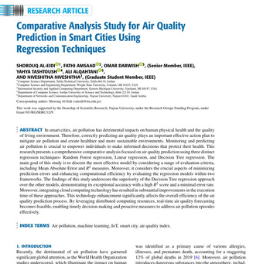

Relevant Research Papers (Verified Sources)
Paper 1
Paper 2
AnOutlier Detection Framework for Air Quality Index Prediction Using Linear and Ensemble Models
Authors: P.K. Dongre, V. Patel, U. Bhoi, N.N. Maltare
Year: 2025
Focus: AQI prediction using Linear, Ridge and Lasso
Regression, and ensemble models.
Finding: Extra Trees performed best after outlier refinement.
🔗 PAPER PDF / SOURCE:
Open Paper 1
PredictingAir Quality Index Using Machine Learning: A Case
Study of Delhi, India
Authors: P. Chanchlani, R. Solanki, P. Bhansari, J.A.A. Jothi, E. Rajasekar
Year: 2025
Focus: Compares Linear, Lasso, Ridge, Decision Tree, Random
Forest, CatBoost, XGBoost and other models.
Finding: CatBoost performed best under 5-fold cross- validation, while AdaBoost performed best under hold-out validation.
🔗 PAPER:
Open Paper 2
https://www.sciencedirect.com/science/article/pii/S2772662
225000025
ResearchGate
(PDF) Comparative Analysis S… PDF | Air pollution has detrimental
impacts on our physical health an…

Slide 13
Conclusion & Key Findings
Effective Prediction: Both Ridge and Lasso regression effectively predict AQI from environmental and weather data.
Ridge's Stability: Ridge regression provides stable predictions, retaining all features and reducing variance.
Lasso's Interpretability: Lasso regression enhances interpretability through automatic feature selection by zeroing out less relevant coefficients.
Contextual Model Choice: The optimal model depends on prioritizing either predictive stability or feature interpretability for specific applications.
Future Enhancements: Integrating ensemble methods could further boost prediction performance and robustness.
This project contributes valuable insights into air quality prediction, providing a foundation for data-driven strategies to enhance environmental monitoring and safeguard public health.

